Slide 1
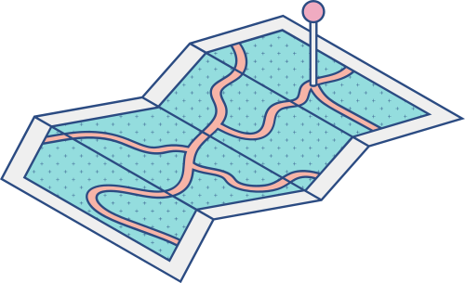
How to make a mind map using Canva
A QUICK INFORMATION GUIDE
An amazing tool to enhance creativity!

Slide 2
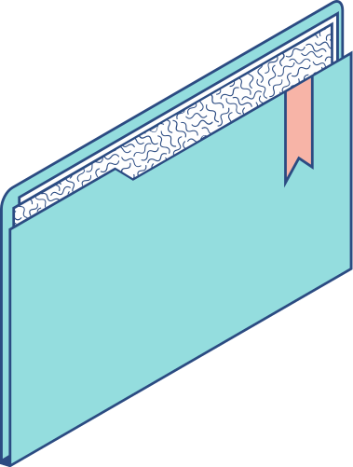
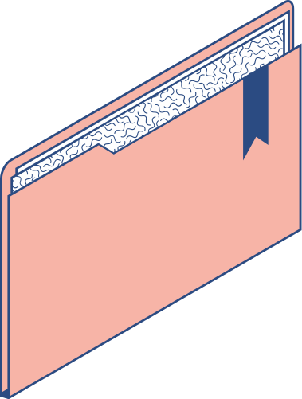
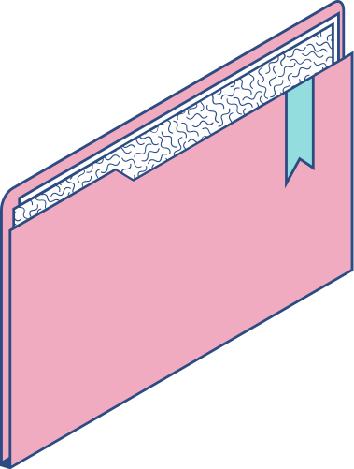
Agenda
KEY TOPICS DISCUSSED IN THIS PRESENTATION
Open a document - To get started
Select a template
Add more features and elements
Customize your design
Download or share your work

Slide 3
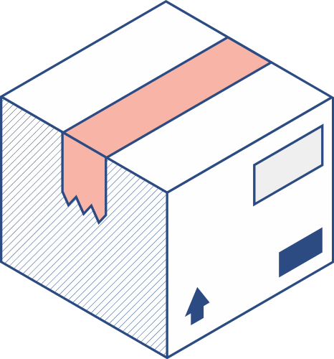
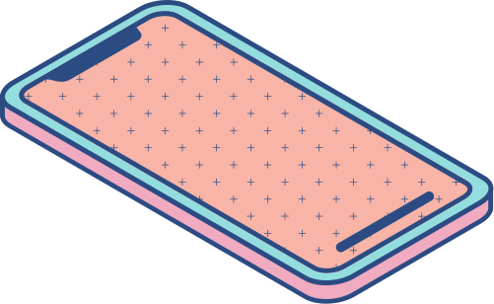
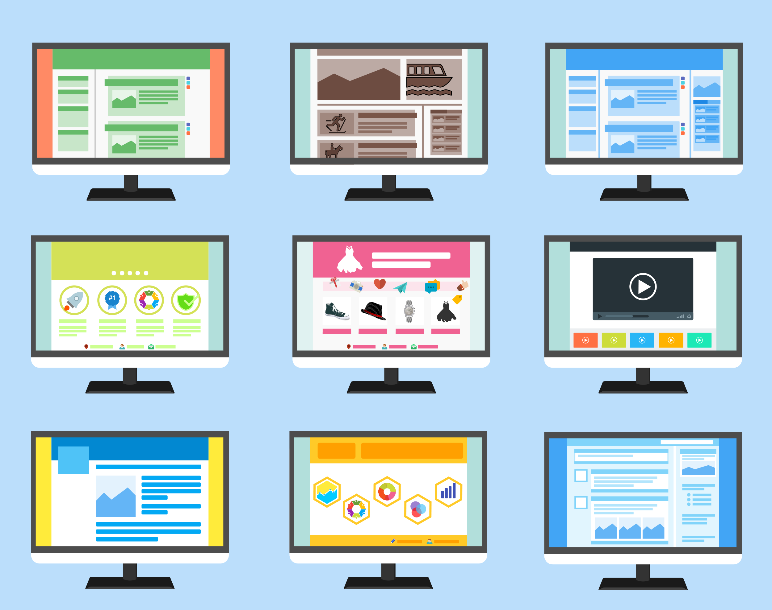
Step 1: Open a document - To get started
Log in to your Canva account or sign up for free using your Facebook or Google profile.
You can launch Canva on desktop or mobile and pull up a brand-new page to start designing in seconds.

Slide 4
Step 2: Select a template
Kick off your creation with a professionally designed mind map template.
Whether you're giving a presentation to business colleagues, helping students brainstorm, or organizing your ideas for a project, you'll find a beautiful template, ready to go.
Filter for color, language, theme or style to get more precise results.

Slide 5
Step 3: Add more features and elements
Add shapes, lines, text boxes, icons and other graphics to map out your thoughts.
Use Canva’s color palette to color code your design and keep things vibrant.
If you’re giving a presentation, you can use the Animate tool to choose how each feature displays itself.

Slide 6
Step 4: Customize your design
Rearrange the layout or get inspiration from a different template to adjust the one you’ve chosen, whether it’s adding a different combination of shapes or using a different color scheme.
You can swap one background for another, shift side panels from left to right or experiment with fonts.

Slide 7
Step 5: Customize your design
Download or share your page
Once you’ve finished your mind map, you can download it, save it as a presentation or post it on LinkedIn, Facebook, Slack, Twitter or any other social media channel.

Slide 8
Do you have any questions?
Send it to us! We hope you learned something new.
aaitizaz@outlook.com

